Slide 1
OPM, CAPM, and MM Theory
Presenter: 林崑峯 周立軒 劉亮志

Slide 2
Assumptions
Firm issues zero-coupond bonds, and prohibit any capital distributions(EX: Dividend) until bond’s maturity “T”
No transaction costs and taxes, so the that the value of firm is unaffected by its capital structure
MM Proposition I is assumed to be valid
There is a known nonstochastic risk-free rate of interest
There are homogeneous expectations about the stochastic process that describes the value of firm’s asset

Slide 3
Merton’s Model
In Robert. C. Merton’s Asset Pricing Model, the claims of Debt holders and Equity holders can be expressed by the following:
For Debt Holders:
Can be thought as the risk-free zero-copound bond (F), plus a Put in short position which underlying asset is firm’s asset (V) and its exercise price is (F)
B = F - P

Slide 4
Merton’s Model
For Equity Holders:
Can be viewed as a Call in long position which underlying asset is firm’s asset (V) and its exercise price is (F)
S = C
Accounting Equation:
Asset = Debt + Equity
V = (F - P) + C
V + P = F + C

Slide 5
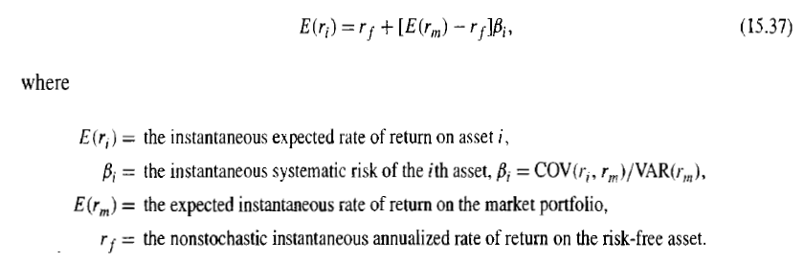
I-CAPM
Because the OPM need continuous trading, but traditional CAPM is a one-period model. So we need I-CAPM as a connection between two models

Slide 6


B-S Call PDE
Black and Scholes first derived the closed form solution for European Call’s value.
If we divide Eq. 15.38 by S, and take limit on dt, we have:

Slide 7


Symbol change
We recognize dS/S as the rate of return on common stock , . And dV/V as the rate of return on firm’s asset, . We have:
And we know

Slide 8

Symbol change
Use Eq 15.40 and 15.41, we can rewrite the instantaneous covariance as
For S, we use BS-Formula OPM to derive

Slide 9
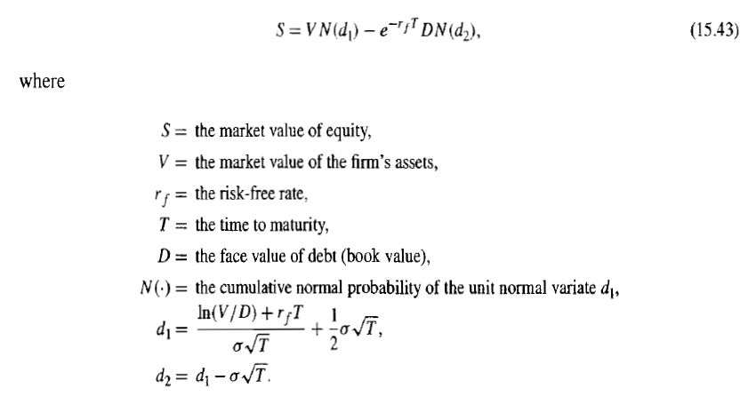
BS Model (OPM)

Slide 10


OPM
Use the BS Formula we derive:
And we rewrite

Slide 11
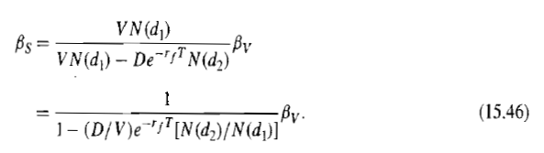
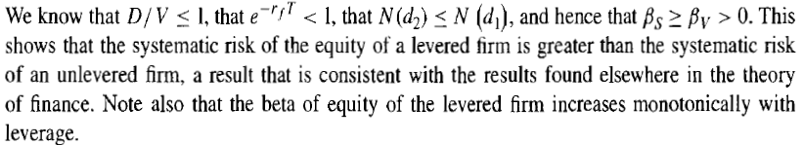
OPM
For S, use OPM, we finally derive

Slide 12

OPM Signs
Use the Eq 15.46, we can obtain some useful signs

Slide 13




OPM vs CAPM
Substituting from into the CAPM, we obtain
Recall that
And since
We obtain

Slide 14

OPM vs CAPM vs MM Propositions
If we assume debts are risky and zero bankruptcy cost, the OPM, CAPM, and MM Propositions can be shown to be consistent.
First, we start from , the systematic risk of risky debt in a world without taxes, can be expressed as

Slide 15


OPM vs CAPM vs MM Propositions
And recall Eq 15.44, the firm’s equity can be thought as a call option on firm’s asset
This two fact imply
And we know the required rate of return of risky debt, can be expressed in CAPM form

Slide 16



OPM vs CAPM vs MM Propositions
Substitute the in Eq 15.51, we have
Substitute the , we obtain
Since = ρ (See P.575)
Risk Premium of a risky bond, θ

Slide 17
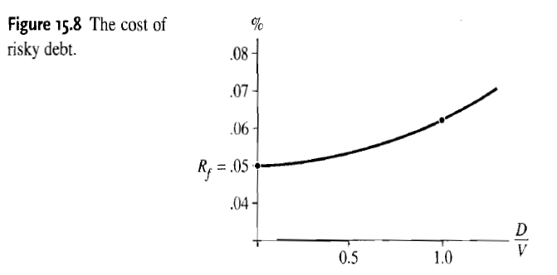
OPM vs CAPM vs MM Propositions
6.3%, When D/V = 1

Slide 18
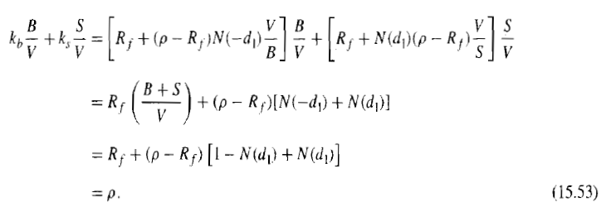

OPM vs CAPM vs MM Propositions
For the WACC, consider the following:
This result is match the MM Propositions:
WACC is irrelevant to changes in the capital structure of the firm, in a world without taxes
And we also have

Slide 19
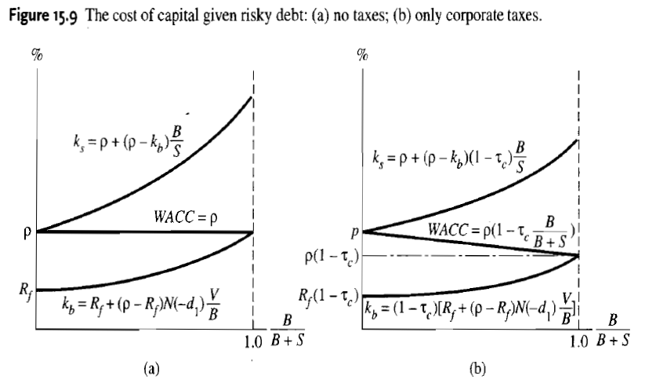
OPM vs CAPM vs MM Propositions

Slide 20
The Separability of Investment and Financial Decisions
The fundamental assumption of MM is that operating cash flows are unaffected by the choice of capital structure
But this is challenged in the last decade
Debt increase may affect the credit
The debt capability needs to be consider
Different debt capability of projects may cause that we cannot treat investments and financial decisions as they are independent

